Slide 1
Auto Pilot
Task 5

Slide 2
Team 4
B.N. | Sec | Name
37 | 2 | Mohammed Ahmed Hassan Ahmed
1 | 1 | Ibrahim Thabet Allam
39 | 2 | Mohammed Hatem Mohammed Saeed
41 | 2 | Mohamed Hassan Gad Ali
43 | 2 | Mohammed Abd El MawgoudGhoneam

Slide 3
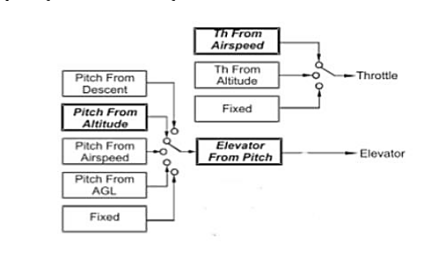
Introduction:
In order to Design a controller first of all we should get the transfer functions of all full longitudinal dynamics model.
Our methodology is to using inner loops architecture.
Then using SISO tool to design the controller.
Finally we use SIMULINK to check the performance of our design.

Slide 4
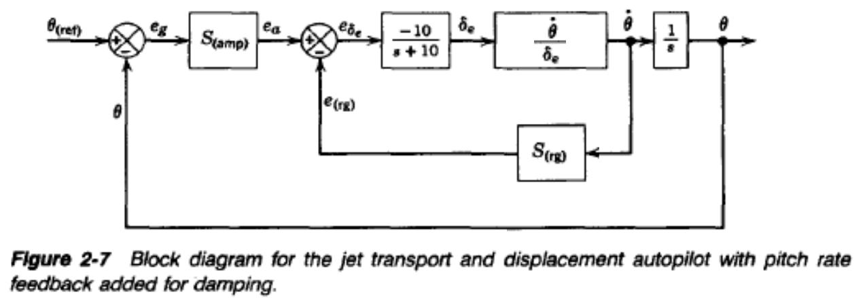
Design Pitch Controller With Pitch Rate Feedback
servo

Slide 5
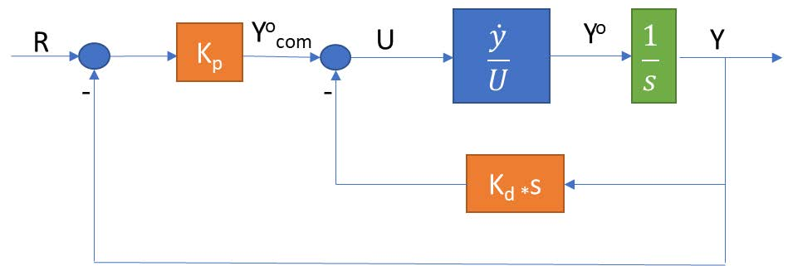
Design Pitch Controller With Pitch Rate Feedback

Slide 6
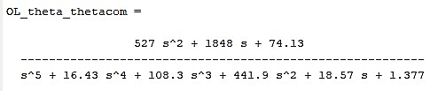
Design Pitch Controller With Pitch Rate Feedback
The open loop transfer function is:

Slide 7
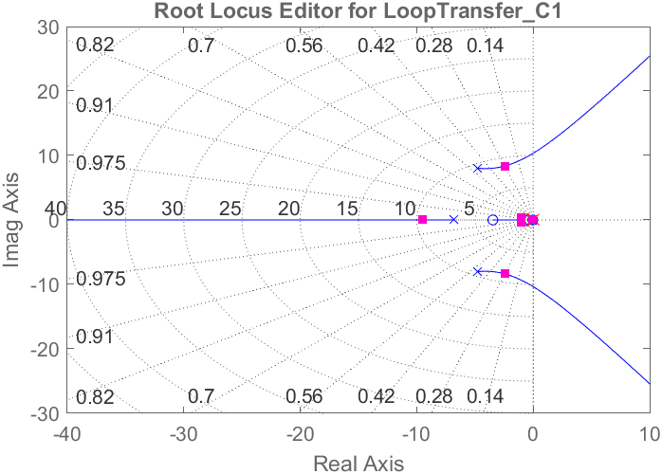
SISO Tool Design
Root locus

Slide 8
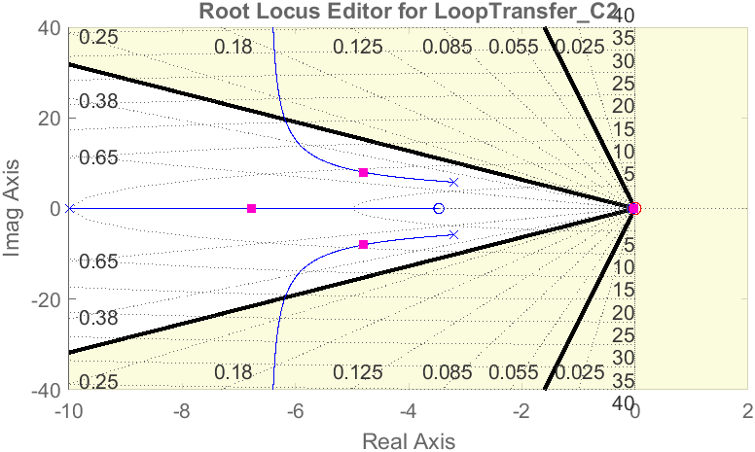
SISO Tool Design
Root locus

Slide 9
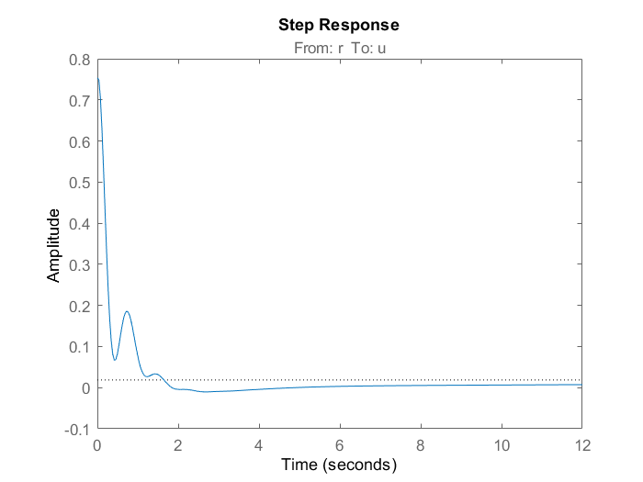
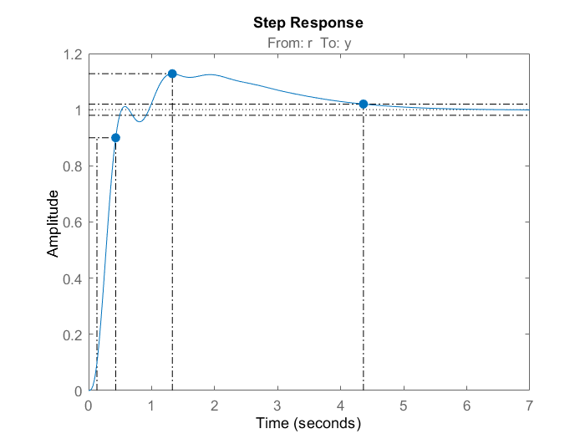
Step response
Control action
System Response

Slide 10
Simulink test

Slide 11
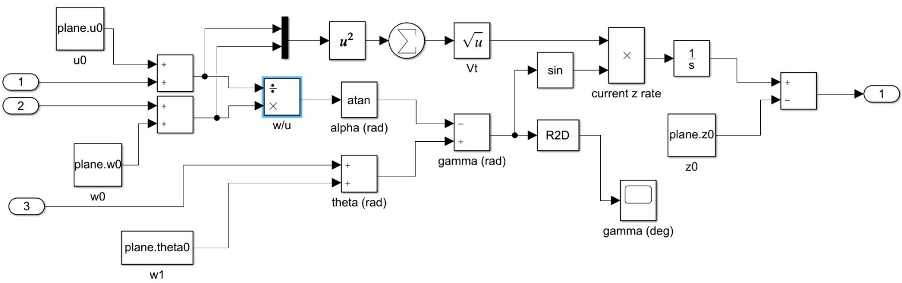
Simulink test

Slide 12

Necessity of velocity control

Slide 13
Necessity of velocity control
when we input positive pitch angle, the action depends on the thrust if the thrust is big enough to climb upward the airplane will climb upward if the thrust is not enough the airplane would dive downward but logically, when the pilot input a positive pitch the airplane should climb upward

Slide 14
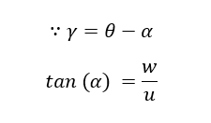
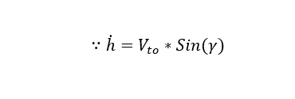
Necessity of velocity control

Slide 15
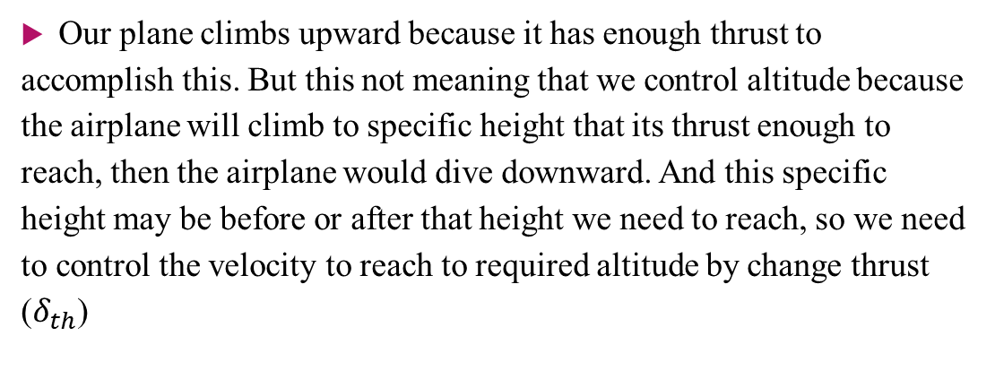
Necessity of velocity control
Our plane climbs upward because it has enough thrust to accomplish this. But this not meaning that we control altitude because the airplane will climb to specific height that its thrust enough to reach, then the airplane would dive downward. And this specific height may be before or after that height we need to reach, so we need to control the velocity to reach to required altitude by change thrust ($δ_{th}$)

Slide 16
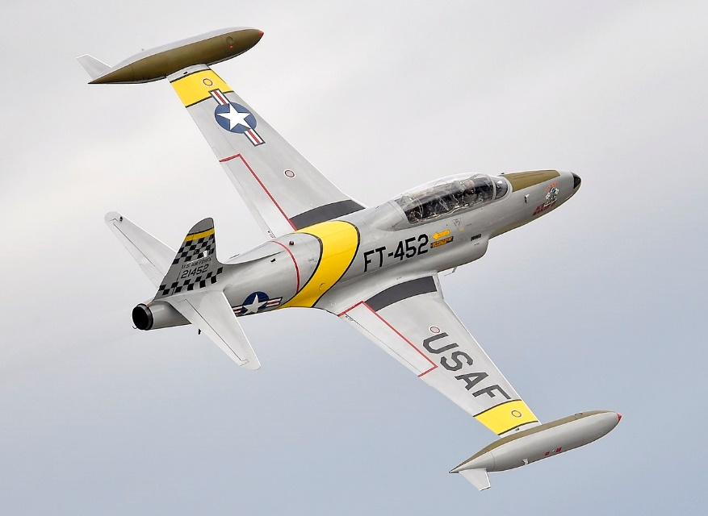
NT-33A engine
Our aircraft ‘NT-33A’ was a training aircraft that was developed from the Lockheed martin.
The Powerplant installed is 1 × Allison J33-A-35 centrifugal flow turbojet engine, with 5,400 lbf (24 kN) thrust for take-off with water injection
4,600 lbf (20,461.82 N) maximum continuous thrust.

Slide 17
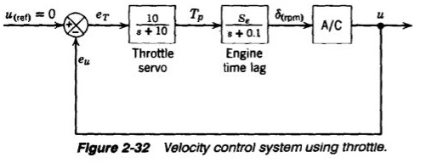
Velocity Controller

Slide 18
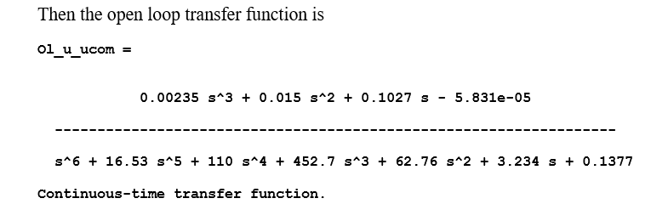
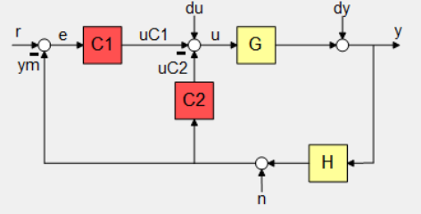
Velocity Controller

Slide 19
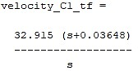
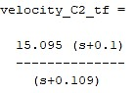
Velocity Controller

Slide 20
Step response & Control action
Step response
Control action

Slide 21
Altitude controller

Slide 22
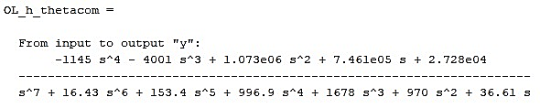
Altitude controller

Slide 23
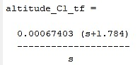
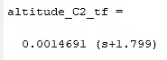
Altitude Controller

Slide 24
Step response & Control action
Step response
Control action

Slide 25

simulation
Results

Slide 26
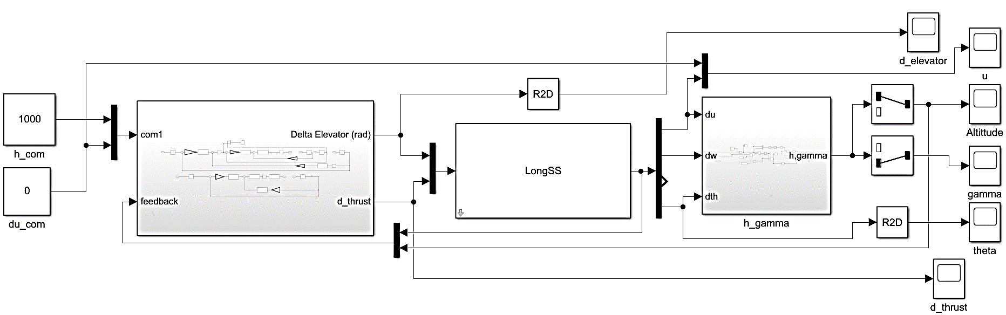
Simulation Blocks

Slide 27
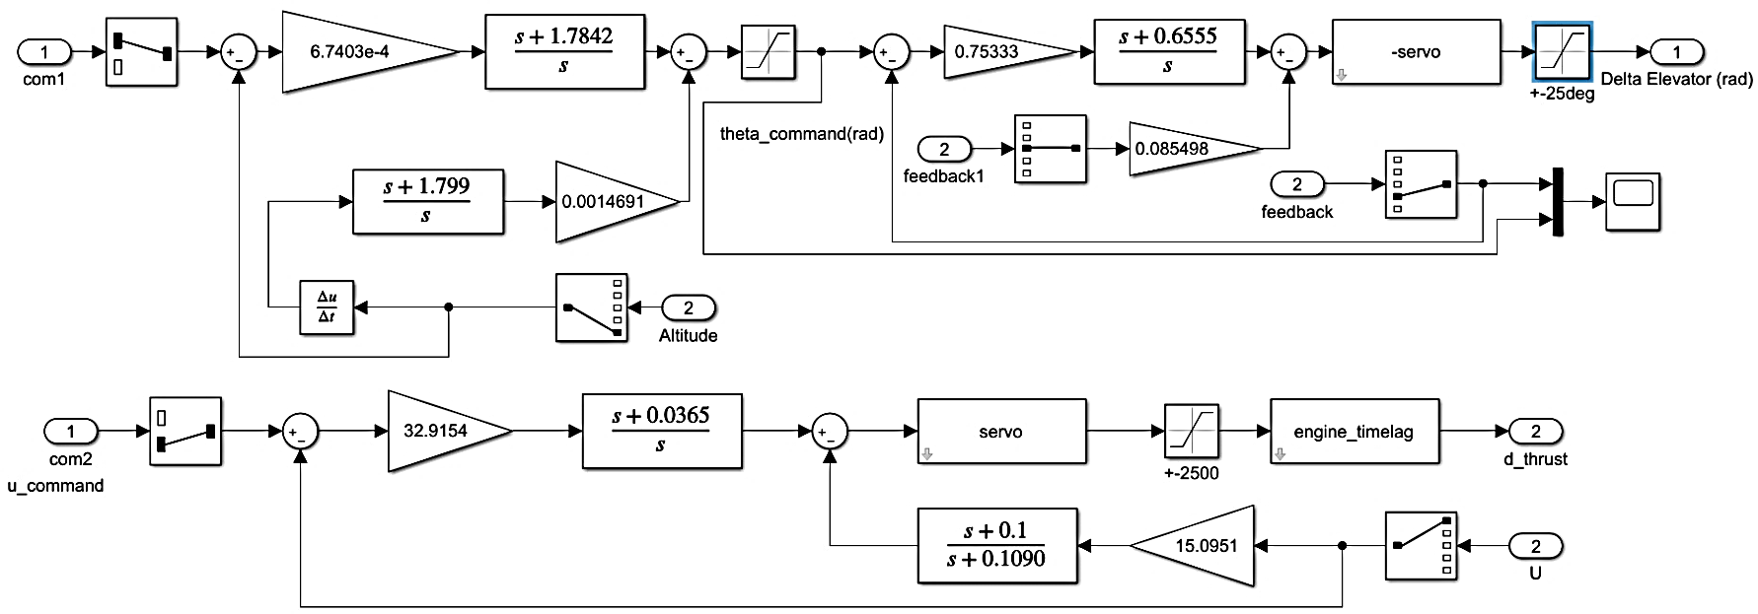
Simulation Blocks

Slide 28
Simulink Results of 1000ft Command

Slide 29
Simulink Results of 1000ft Command

Slide 30
Simulink Results of 1000ft Command

Slide 31
Auto Pilot
Task 6

Slide 32
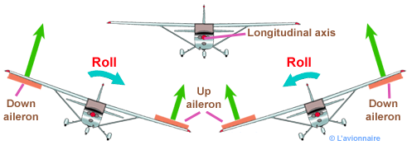
Lateral Control
The rule of the lateral autopilot is to control the motion of the airplane in the lateral-directional plane, it controls the rudder & aileron to achieve a coordinated turn
What is coordinated turn ??

Slide 33
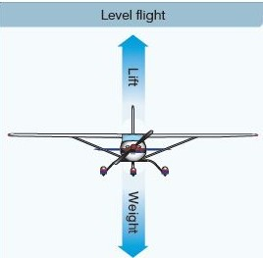
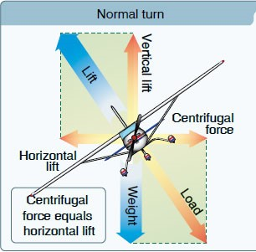
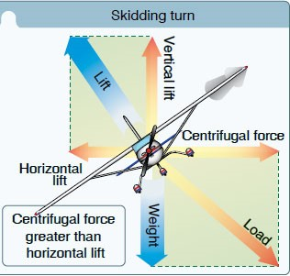
coordinated turn We may call it “zero-lateral acceleration turn”
In terms of mechanics
Normal flight
Medium banked turn
Steep banked turn

Slide 34
coordinated turn
In terms of aerodynamics
When lift increases in one of the wings the drag also increases
On that wing resulting in “adverse yaw phenomenon”
To overcome this phenomenon we need rudder input

Slide 35
coordinated turn
In terms of aerodynamics
The coordinated turn is a maneuver in which the airplane’s heading angle is changed (airplane turns) without “slipping or skidding”, i.e. the side slip angle (β = 0). note: skidding is having +ve sideslip angle (β>0) while slipping is having -ve sideslip angel (β<0)

Slide 36
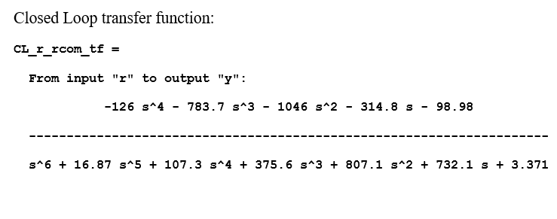
“Yaw damper” for the Dutch roll mode
Design

Slide 37
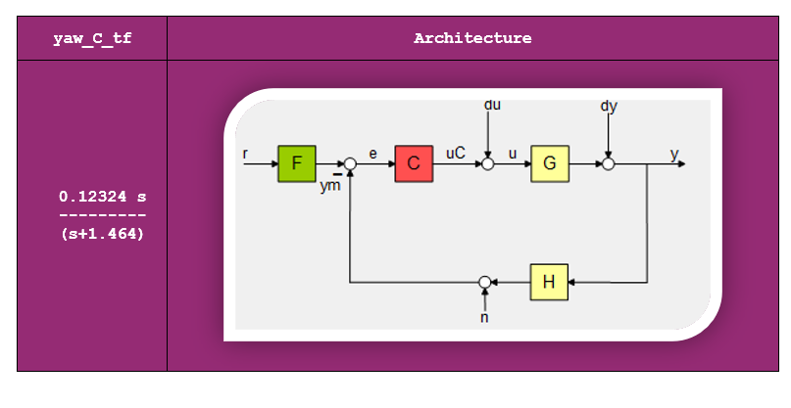
“Yaw damper” for the Dutch roll mode
Design

Slide 40
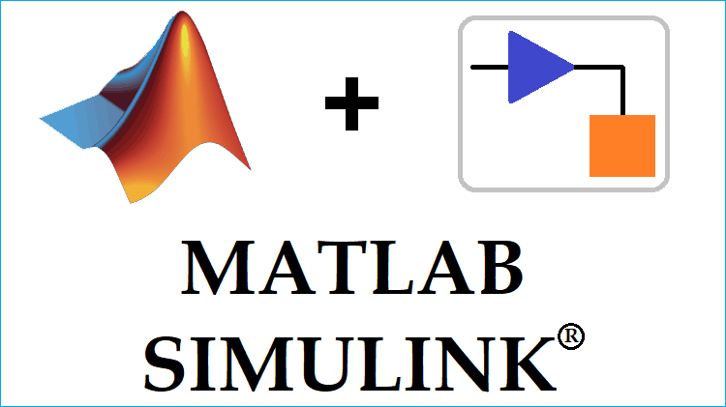
Test The “Yaw damper” controllers on the full state space model

Slide 41
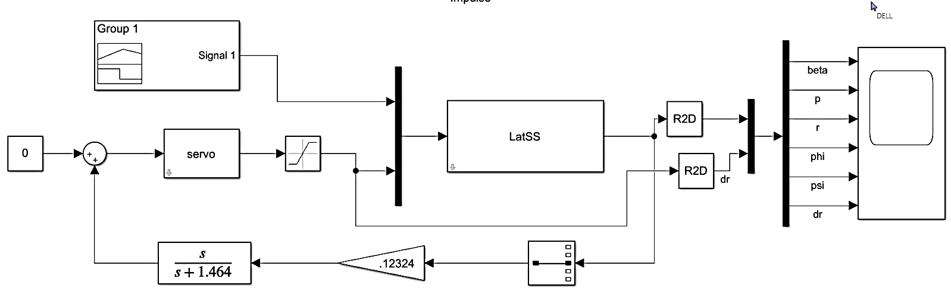
Simulink Test

Slide 42
Test Result

Slide 43
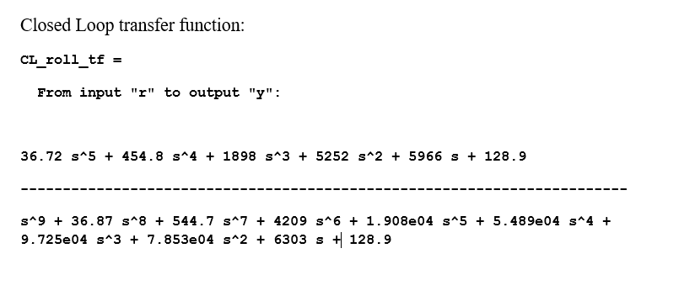
Roll Controller

Slide 44
Roll Controller
Design

Slide 45
Response

Slide 46
Control Action

Slide 47
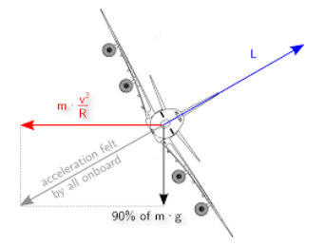
Coordination

Slide 48
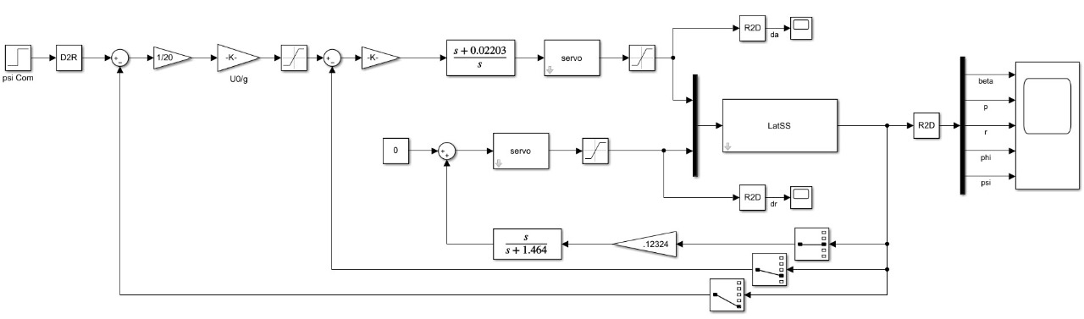
Lateral controller Test with Simulink

Slide 49
Result

Slide 50
Autopilot
Task 7

Slide 51
Autopilot Testing on Non-Linear Simulation
Lateral Autopilot
Longitudinal
Autopilot
Autopilot Controller

Slide 52
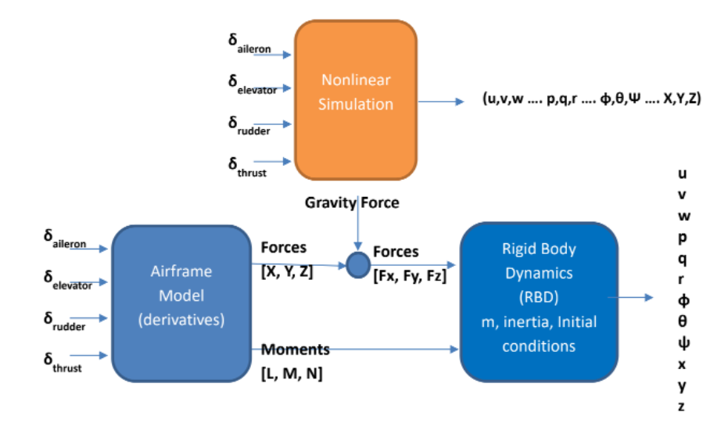
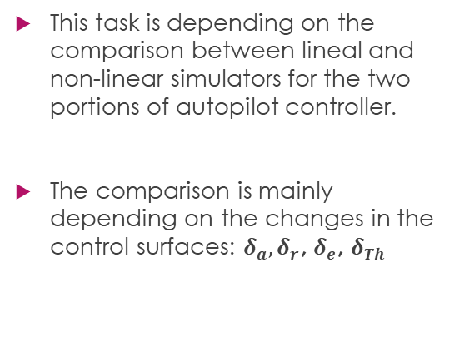
Autopilot Testing on Non-Linear Simulation
This task is depending on the comparison between lineal and non-linear simulators for the two portions of autopilot controller.
The comparison is mainly depending on the changes in the control surfaces: $δ_{a}, δ_{r}$, $δ_{e}$, $δ_{Th}$

Slide 53
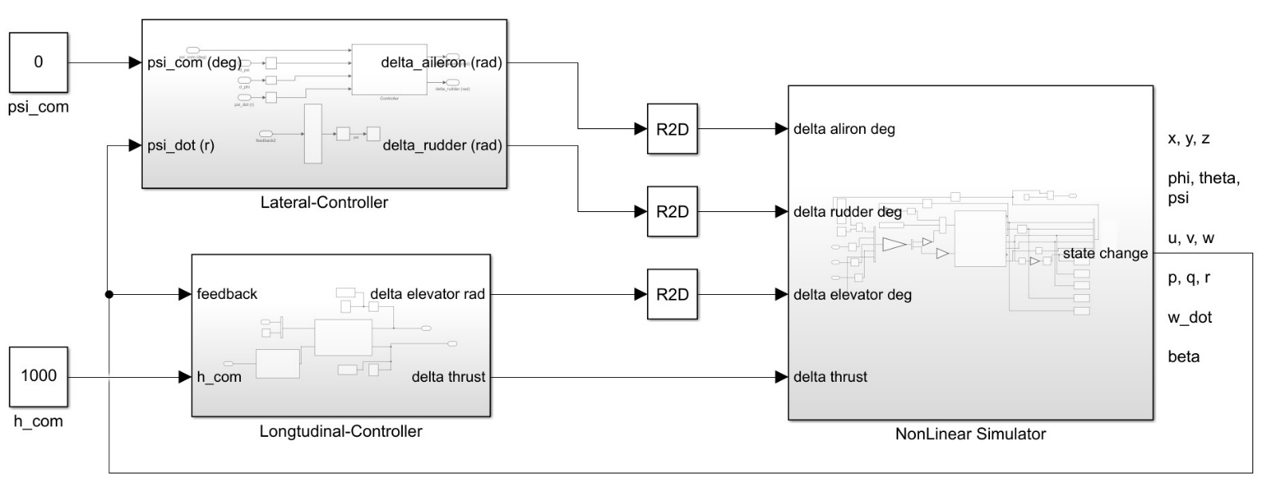
Develop the testing loop containing the “Controller + Simulator”

Slide 54
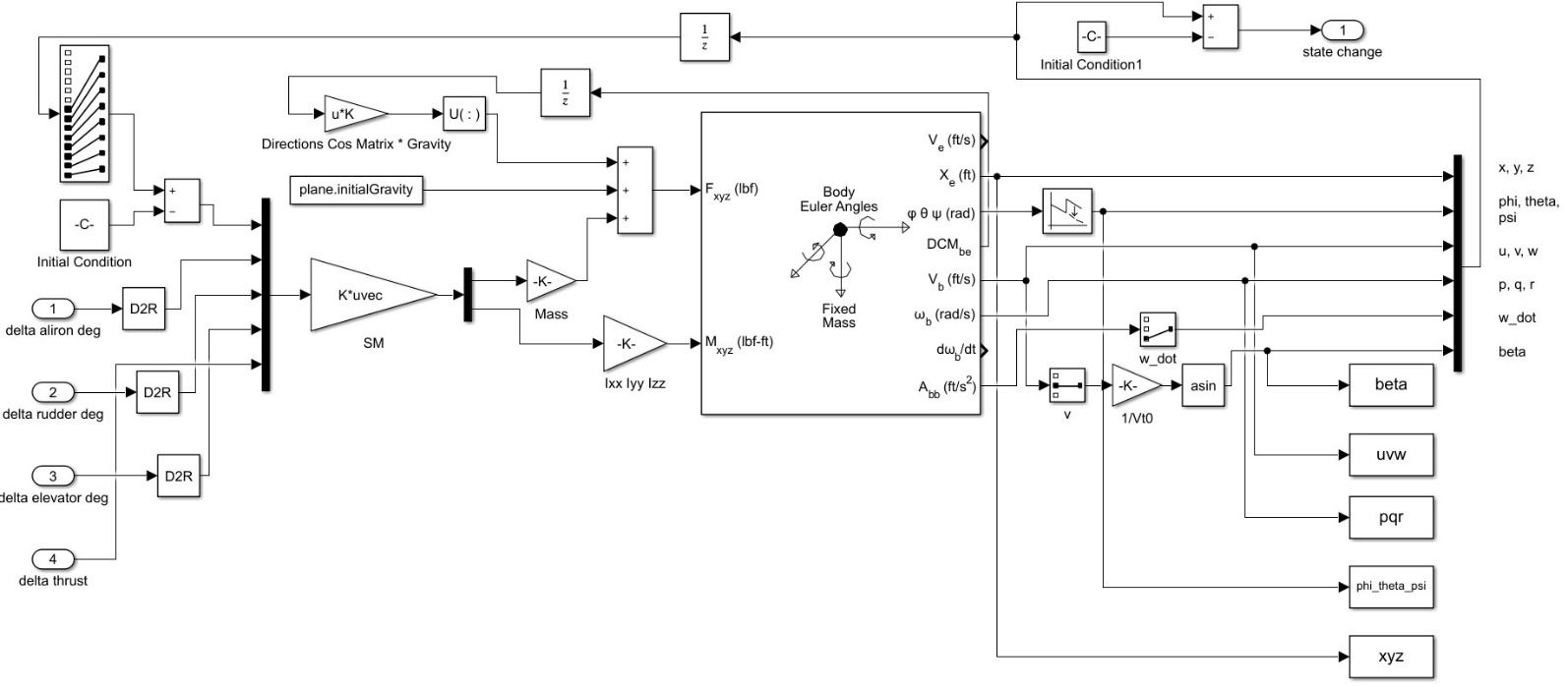
Develop the testing loop containing the “Controller + Simulator”

Slide 55
Test the “Pitch controller” for $33.5°$
1- u

Slide 56

Test the “Pitch controller” for $33.5°$
2- $γ$

Slide 57

Test the “Pitch controller” for $33.5°$
3-$θ$

Slide 58

Test the “Pitch controller” for $33.5°$
4- $δ_{elevator}$

Slide 59
Test the “Pitch controller” for $33.5°$
5- h

Slide 60
Test the “Pitch controller + Velocity controller” for 15$°$
1- u

Slide 61
Test the “Pitch controller + Velocity controller” for 15$°$
2- Theta

Slide 62
Test the “Pitch controller + Velocity controller” for 15$°$
3- h

Slide 63
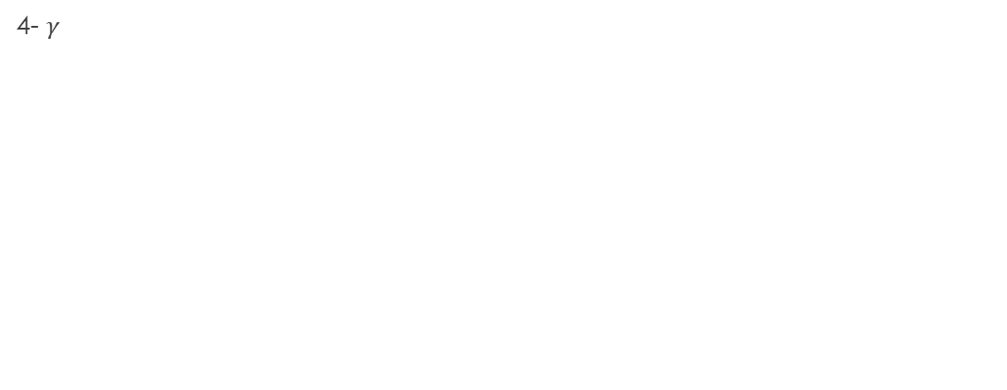
Test the “Pitch controller + Velocity controller” for 15$°$
4- $γ$

Slide 64
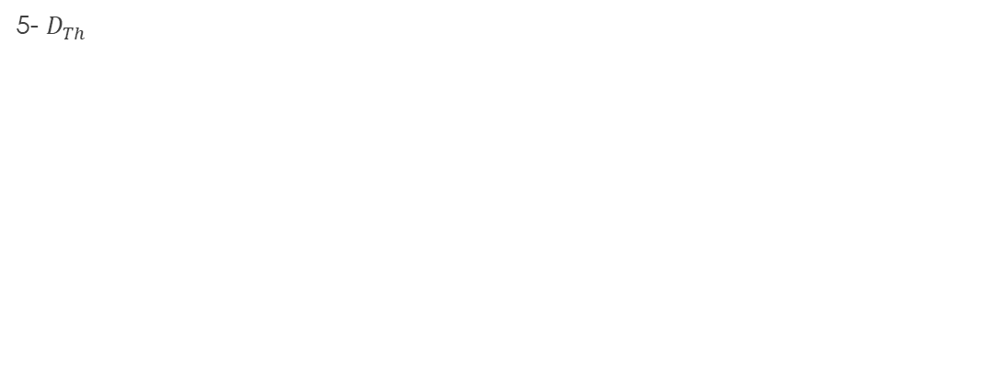
Test the “Pitch controller + Velocity controller” for 15$°$
5- $D_{Th}$

Slide 65
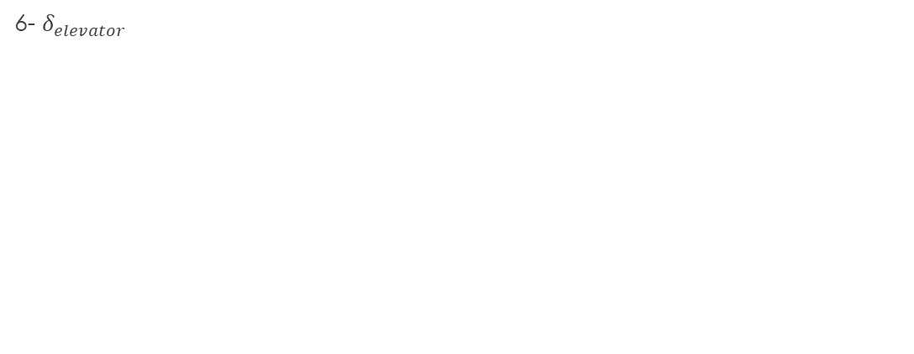
Test the “Pitch controller + Velocity controller” for 15$°$
6- $δ_{elevator}$

Slide 66

Test the “Altitude Hold” of 1000 ft
1- $θ$

Slide 67
Test the “Altitude Hold” of 1000 ft
2- u

Slide 68

Test the “Altitude Hold” of 1000 ft
3- $γ$

Slide 69
Test the “Altitude Hold” of 1000 ft
4- h

Slide 70

Test the “Altitude Hold” of 1000 ft
5- $δ_{elevator}$

Slide 71

Test the “Altitude Hold” of 1000 ft
6- $δ_{Thrust}$

Slide 72
Thanks

